Slide 1
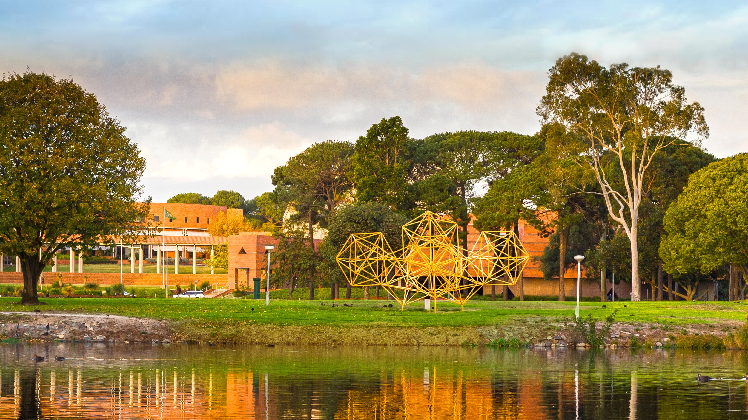
Milestone 1
Christopher Reid
John Curtin Distinguished Professor
Dean Graduate Studies, Curtin University
Graduate Research School
Notes:
Thanks very much and I am pleased to have the opportunity to discuss with you what I see as one of the most exciting developments in clinical and medical research in this country coming at a time when Curtin University has
A very strong allied health training reputation in most of the key disciplines
The newest medical school in the country and
is becoming a major force in health research not only in he State but also Nationally.

Slide 2


Acknowledgement of Country

Slide 3


Organisational Progress for HDR Students –
Milestone Model for Progression
Milestone 1
Milestone 2
Milestone 3
Enrolment
Examination

Slide 4
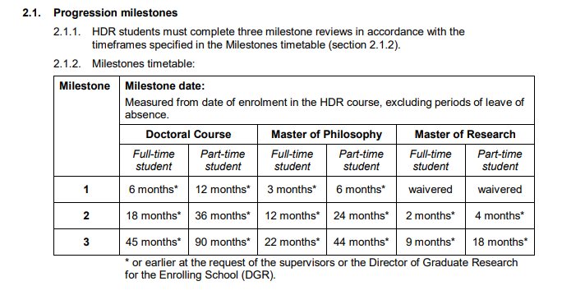
Milestone Progression Timelines
Milestone 1
Milestone 2
Milestone 3
Enrolment
Examination

Slide 5
Enrolment to Milestone 1?
Milestone 1
Enrolment

Slide 6
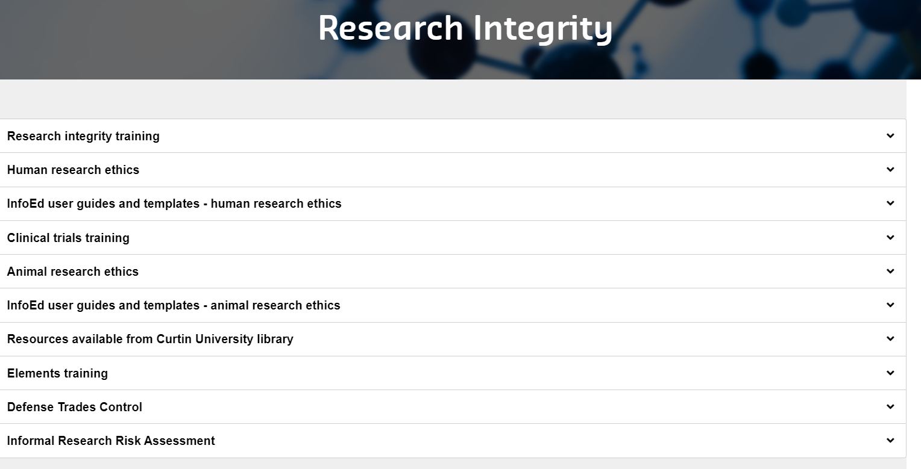
Key Requirements – Research Integrity Training
Complete before
Milestone 1
Curtin Values
Integrity,
Respect,
Courage,
Excellence,
Impact

Slide 7

Requirements – Management of Data
Research Data and Primary Materials P&P– covers collection; storage; ownership; access; data sharing; retention periods; confidentiality; destruction.
The Library: Research Data Management Planning Tool – to help you create a data management plan. Your supervisor can then request R:drive storage on your behalf
Research Data Management LibGuide
Retention and disposal of data should be in line with WA State government Disposal Authorities.

Slide 8

Requirements – Understand Academic Integrity
Universities Australia (2017) definition: ‘Academic integrity means acting with the values of honesty, trust, fairness, respect, and responsibility in learning, teaching and research’.
Principles of academic integrity align with Curtin’s core values (integrity, respect, courage, excellence and impact).
“Plagiarism is presenting the work or property of another person as your own without appropriate acknowledgement or referencing…”
For more info see Academic Integrity Governance and
Academic Integrity student essentials
Management of Academic Integrity Warnings for New to Curtin Students Procedure

Slide 9


Developing Your Research Proposal
Planning with your Supervisors
Understanding what’s been done and what needs to be done
Framing the research question
Methods
Resources
Equipment
Write it all down!!
Need help? Do a Library workshop
‘Research Proposal Series’

Slide 10
Organisational Progress for HDR Students –
Milestone Model for Progression
Milestone 1
Milestone 2
Milestone 3
Enrolment
Examination

Slide 11


M1 – Application
Outcome is due to the GRS after 6 months FTE (Doctoral) and 3 months FTE (Masters).
Field of Research
  Select one six digit FoR that best defines the research thesis.
Apply for an ORCID (open researcher and contributor ID).
  Register via the ORCID website
Complete the Research Initiation Guide
Complete the Research Integrity training (on Blackboard)
Complete a Research Data Management Plan
  See Library RDM Libguide
Complete Milestone 1 Application Form
  See Milestones
Students normally only have ethics approved after M1 is approved.
    The Principal supervisor may already have ethics approval, but it MUST cover the proposal.
    The Supervisor is responsible for this governance.

Slide 12
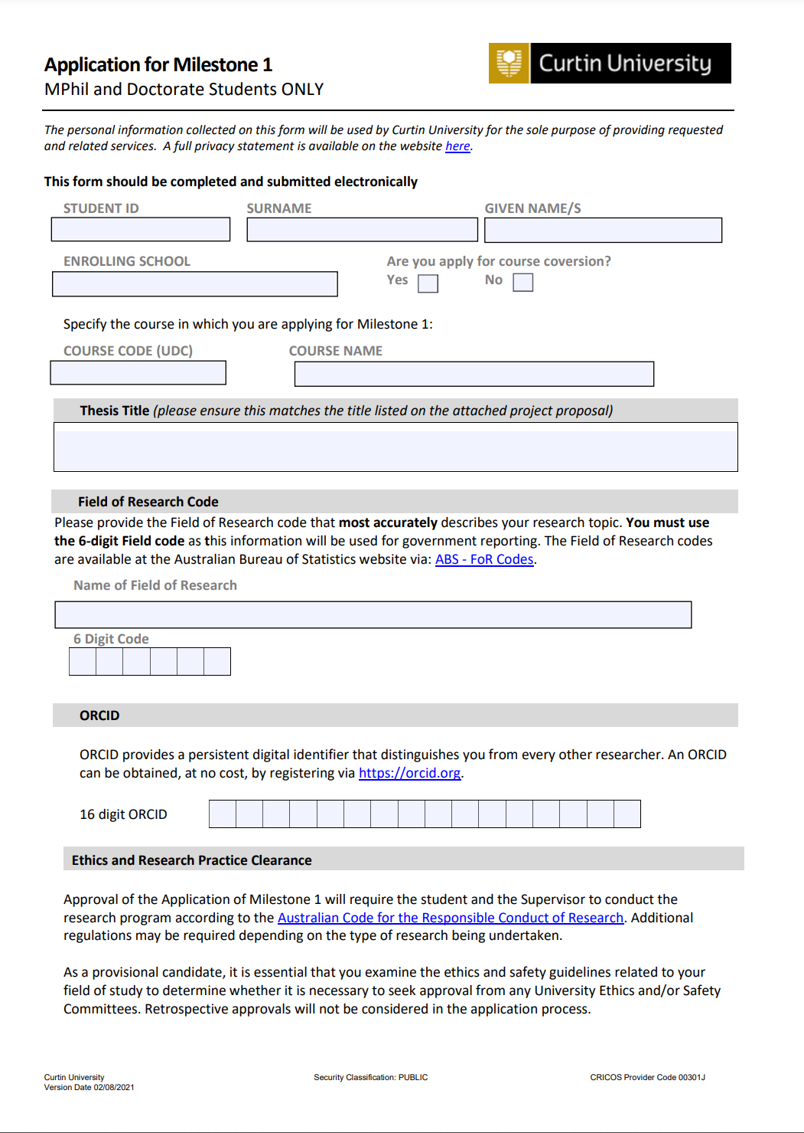
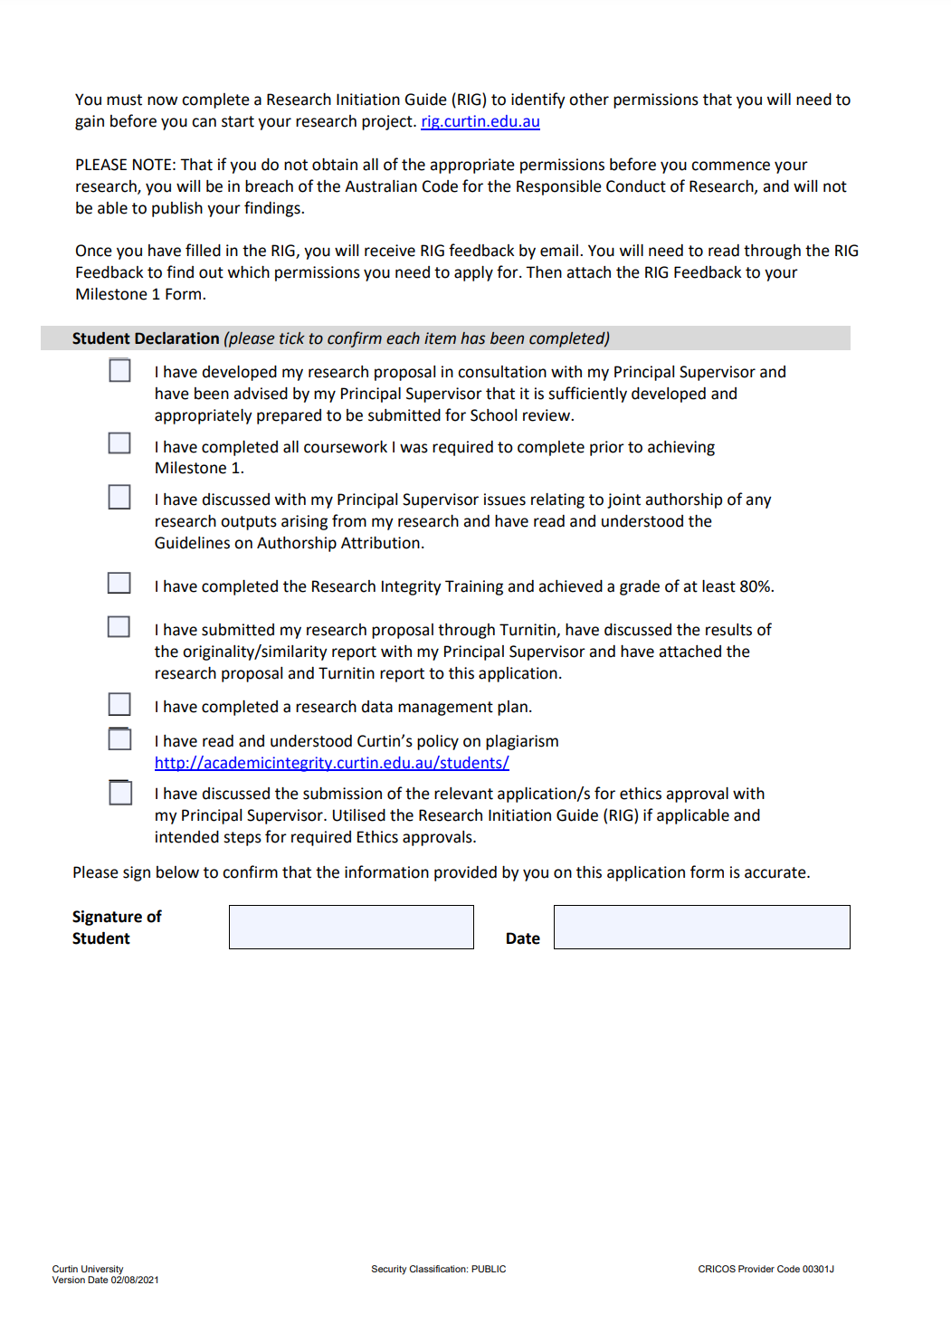
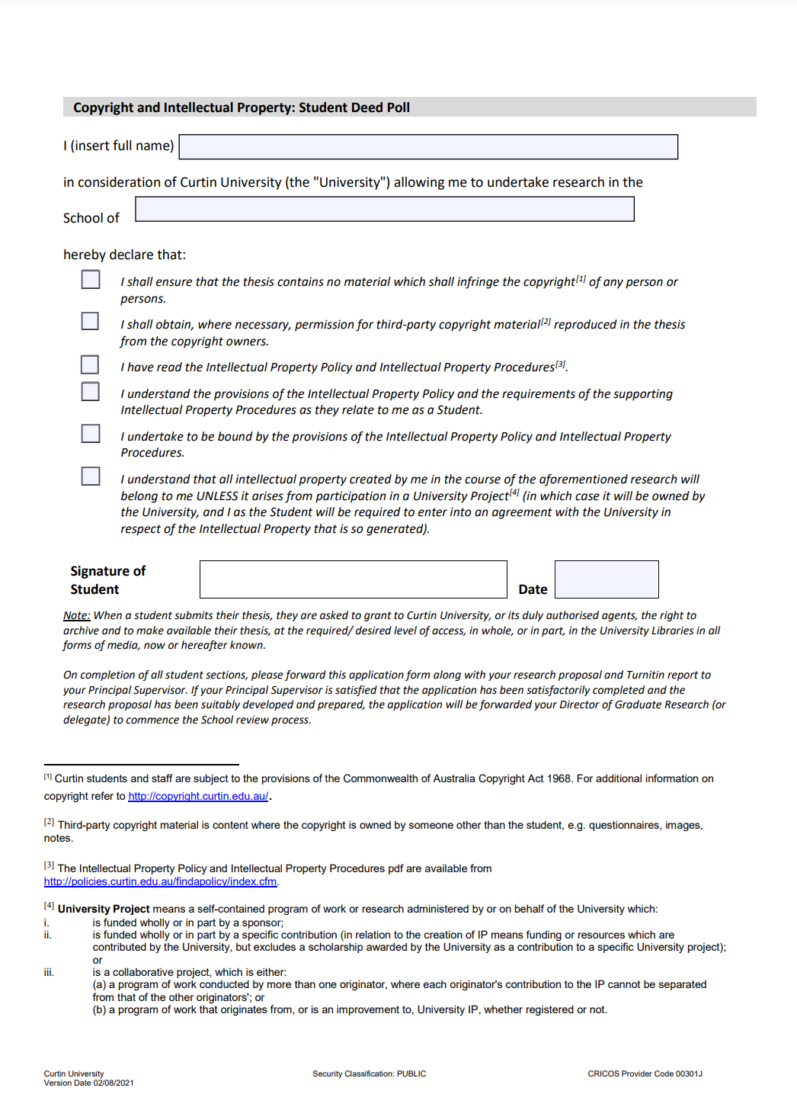
Milestone Application Forms

Slide 13
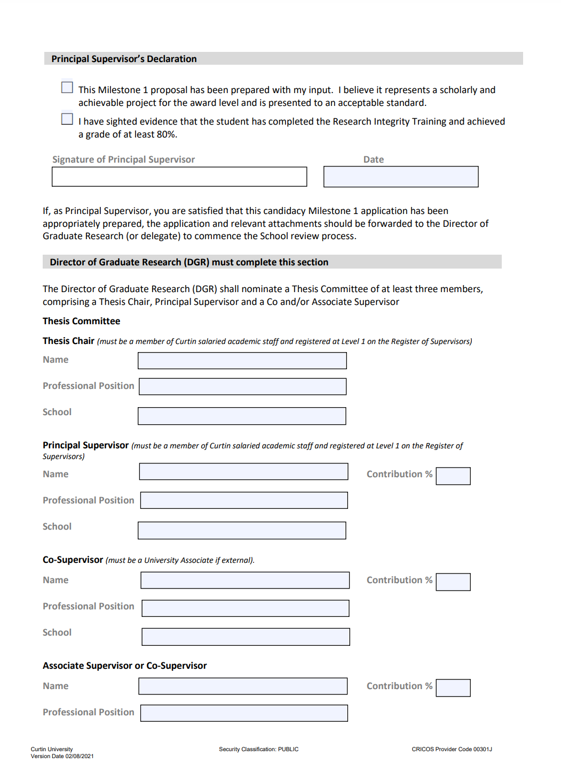
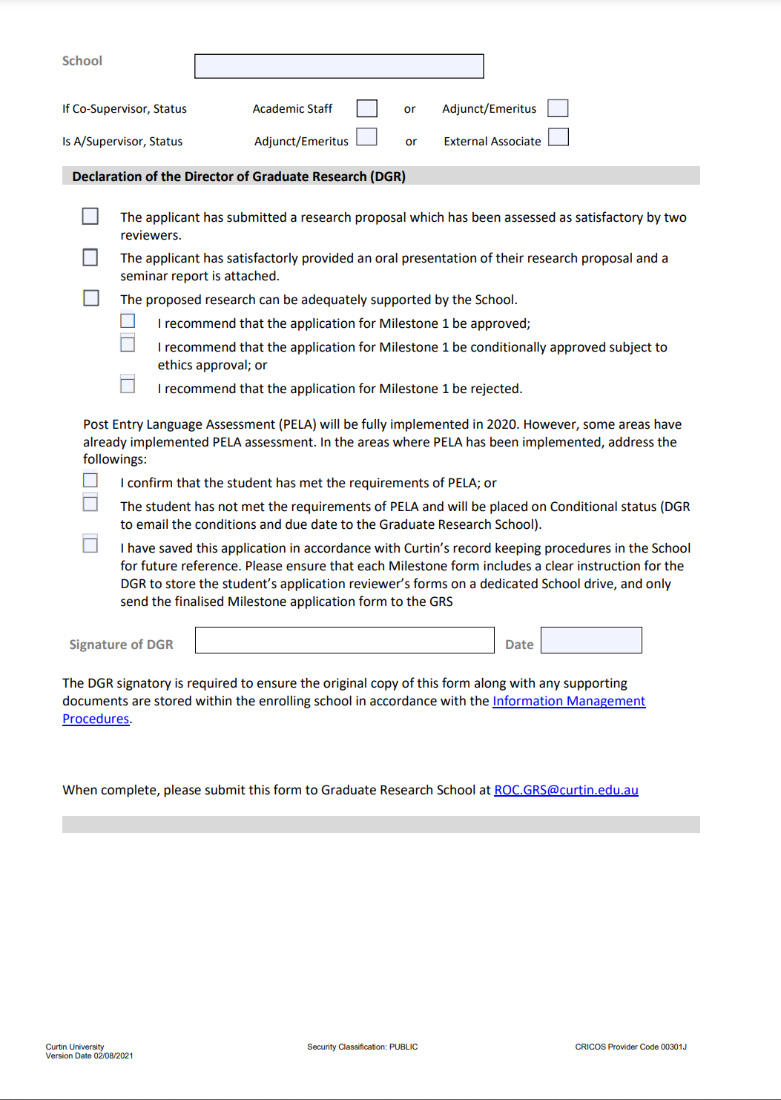
Milestone Application Forms

Slide 14
Developing Your Research Proposal
Masters Students x 5 pages; Doctoral x 10 pages for (not including references and appendices)
  Title and Abstract
  Background, which situates the project in the scholarship.
  Detailed description of methodology and methods
  Detailed project timeline – recommend a monthly Gantt chart
  Full budget – including, but not restricted to, how the project will use the Research Support Fund allocation (Reimbursable items).
Expected Publication Standard - well edited
Uploaded to Turnitin (‘Originality Checking’ link in Research Integrity training on Blackboard)

Slide 15

Milestone 1 Requirements – Oral Presentation (6 months)
Formal presentation to the School
  Background
  Research Question and Protocol
  Address Feasibility / Budget etc
Supervisors and reviewers attend
You will receive feedback, revision may be required
Your Supervisor will advise DGR when changes have been made
The GRS will advise when your M1 has been approved
Tip
Apply for ethics after
M1 is approved and
finalised

Slide 16
Available facilities/resources for undertaking the research
Essential Facilities – for links to Guidelines for Essential Facilities; and Research Support Fund
Reimbursement List
  High cost courses Doctoral up to $ $3,325 at M1 & M2
  Low cost courses Doctoral up to $ 2,450 at M1 & M2;
  Masters up to half above as relevant
Eligible Expenses include;
  Research related travel
  Books/texts
  Thesis production
  Research participant costs
  Publication costs
  Creative production costs
Students must use Concur to claim reimbursements.
Currently Under Review
Schools
Computer / printer/
basic software
Desk/Chair
Access to facilities
Currently Under Review

Slide 17
Available facilities/resources for undertaking the research
Engagement grant – new in 2022
Rationale:
The rationale for this is that it can be used to Support Doctoral Candidates for engagement activities that include:
  Fieldwork trips,
  Internships (travel and supports) - ONLY for RTP eligible Internships.
  Registration for dissemination of research outputs.
  Travel to research laboratories / conference as per the former mobility program.
The Fieldwork must be approved and supported in the Candidacy document.
The Internship must be approved and supported in the first 1.5 years enrolment.
The mobility must be identified/ planned in M#2 and taken prior to M#3 due date.

Slide 18
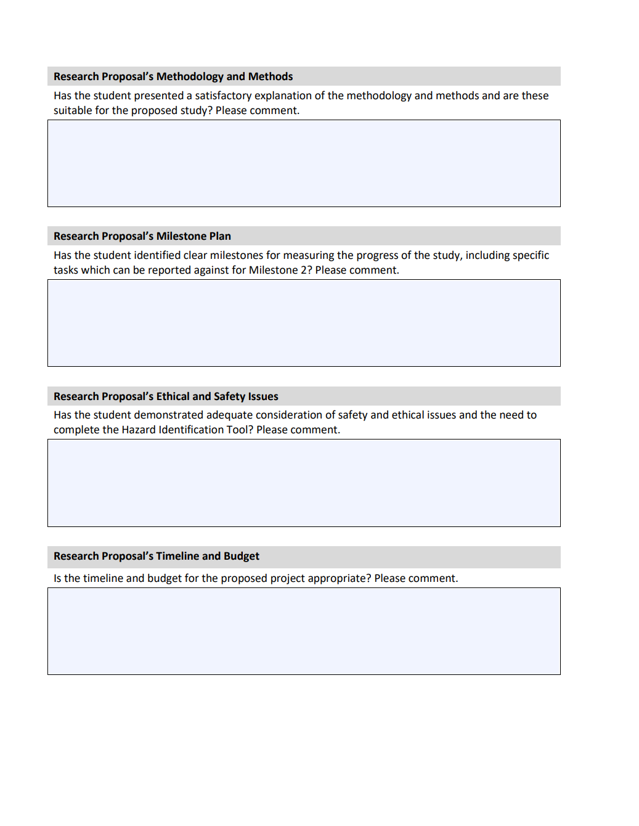
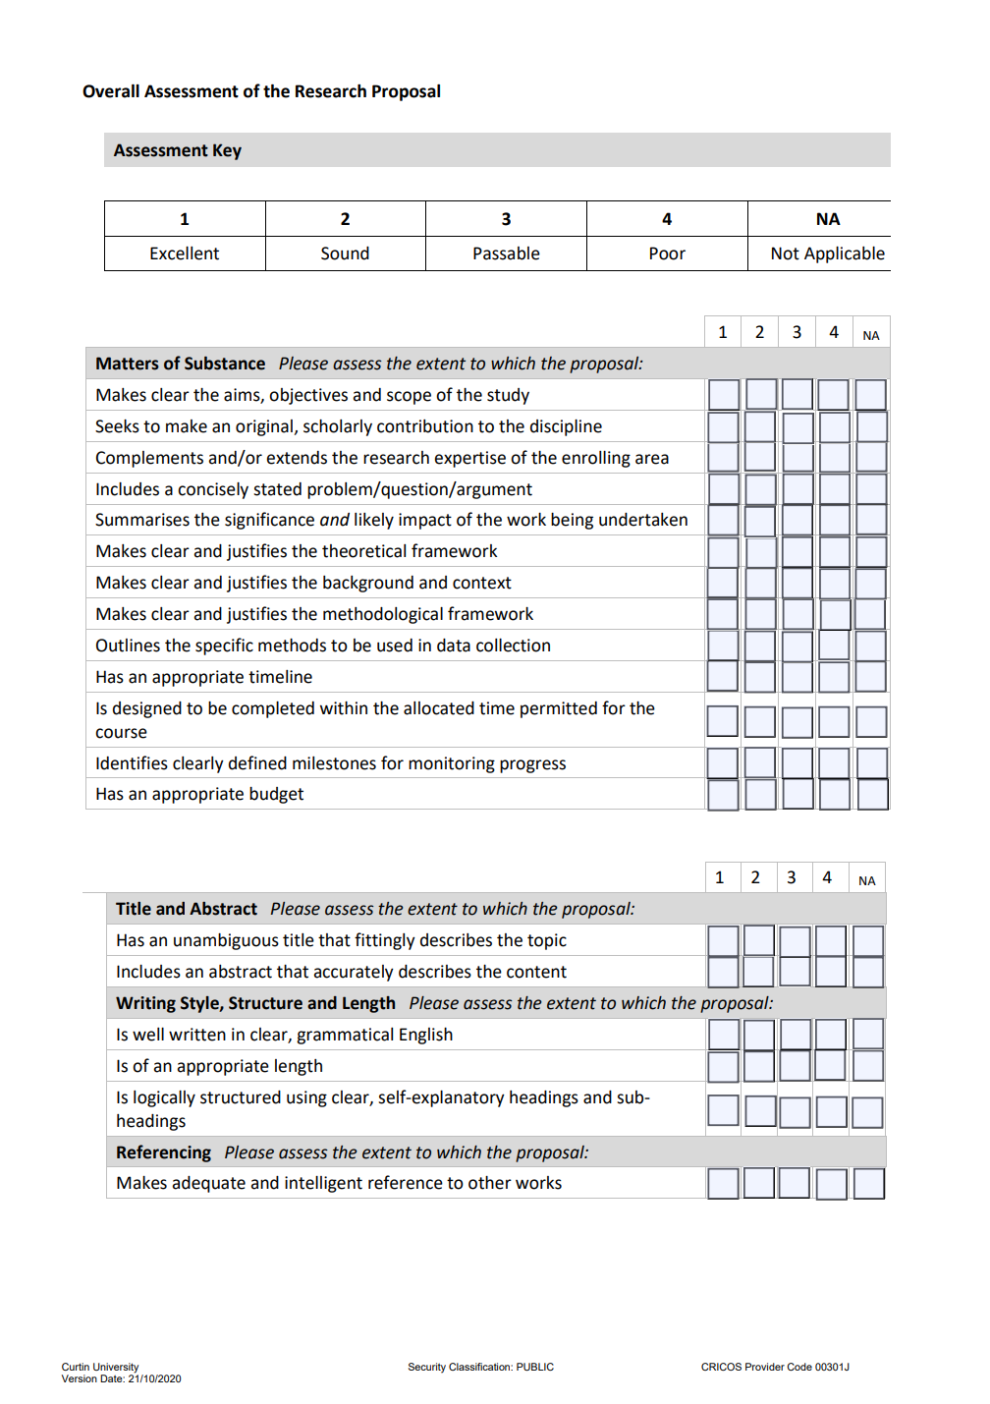
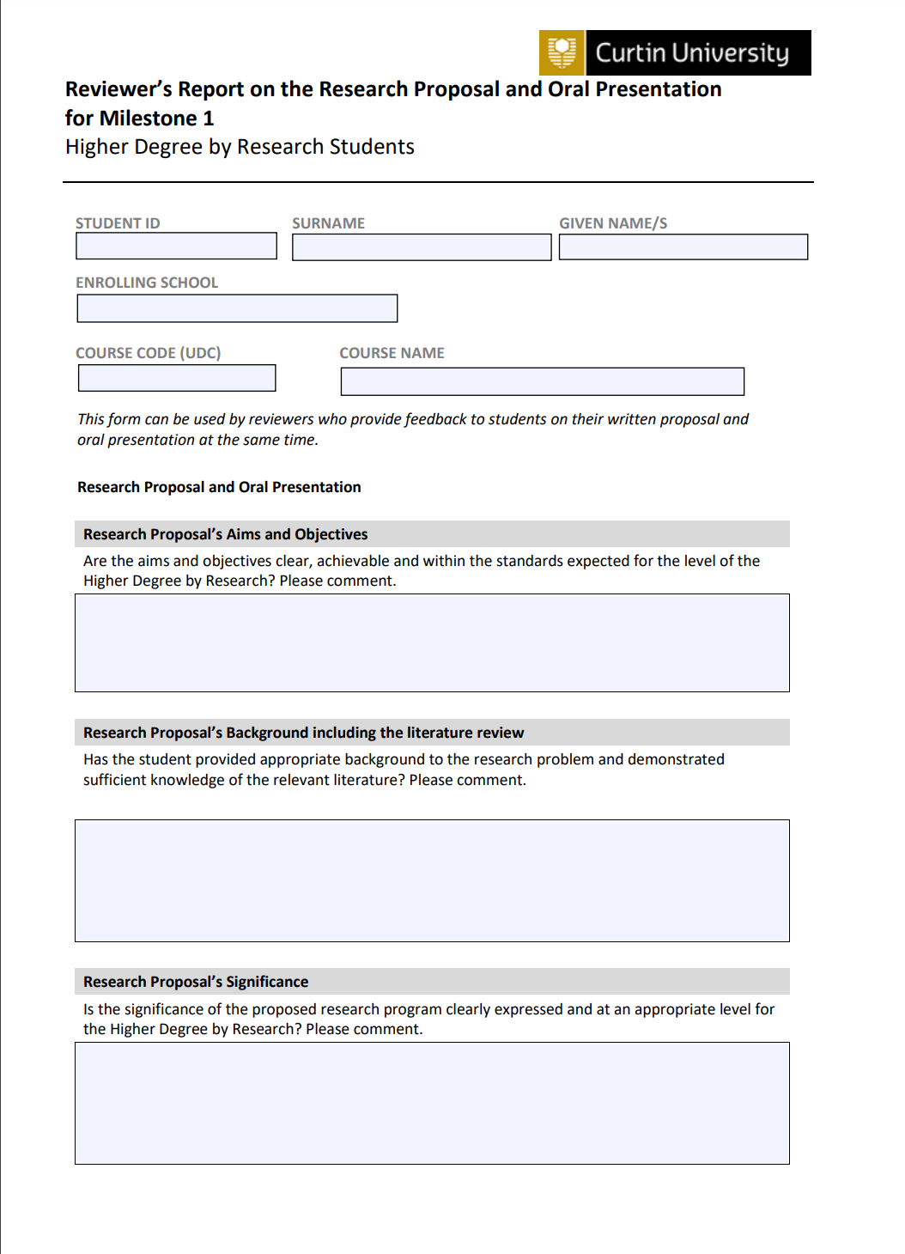
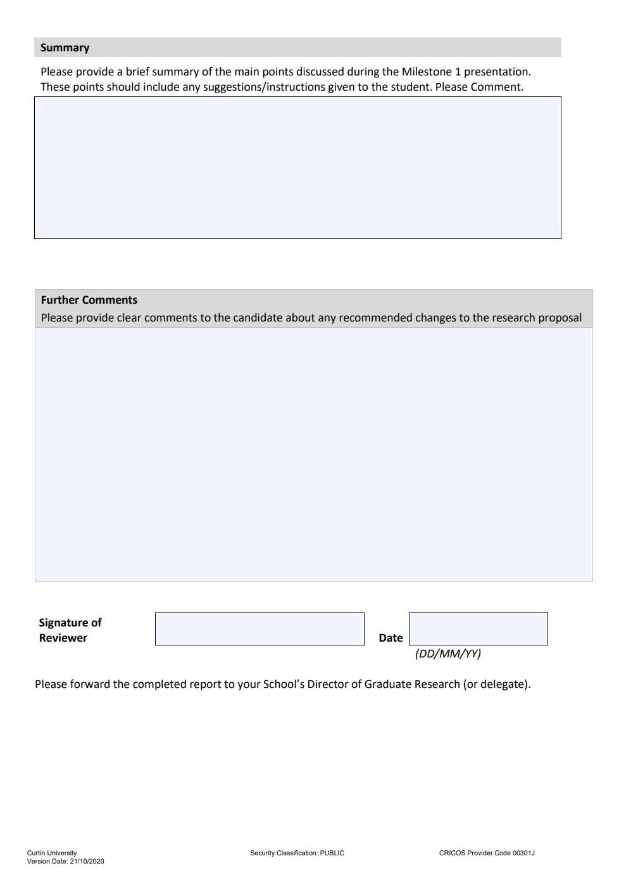
Milestone 1 Reviewers Report

Slide 19
Milestone 1 - outcome
Two reviewers – provide feedback to Thesis Chair (scope; project design; feasibility; budget; timeline; ethics)
Thesis Chair can request student make changes.
Thesis Chair recommends to DGR: approve; approve subject to ethics; or reject
DGR determines outcome. If in doubt DGR can refer on to another DGR or Dean of Research

Slide 20
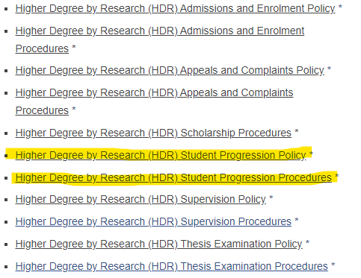
Policy & Guidelines
See HDR Policy and Procedures https://policies.curtin.edu.au/findapolicy/index.cfm#h
to access these

Slide 21
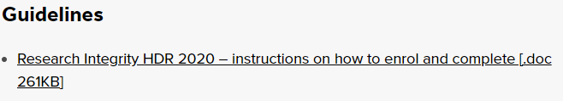
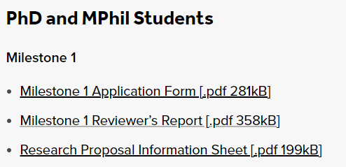
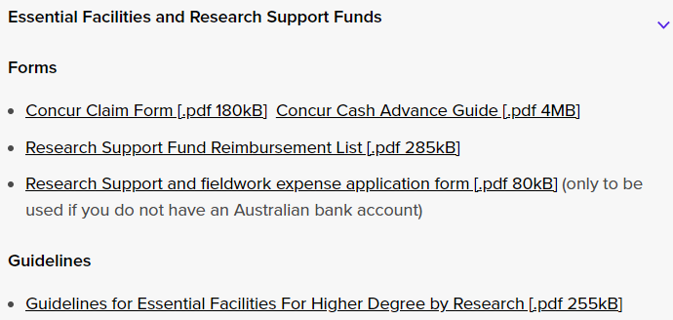
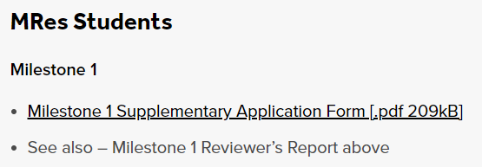
Forms
See HDR Forms, guidelines

Slide 22
GRS Contacts
GRS - Building 101 (entry opposite medical centre)
ROC.GRS@curtin.edu.au for all HDR queries or
ROC-Excellence@curtin.edu.au for training
Phone: +61 8 9266 3337
Visit websites
    Higher degree by research
    Milestones

Slide 23
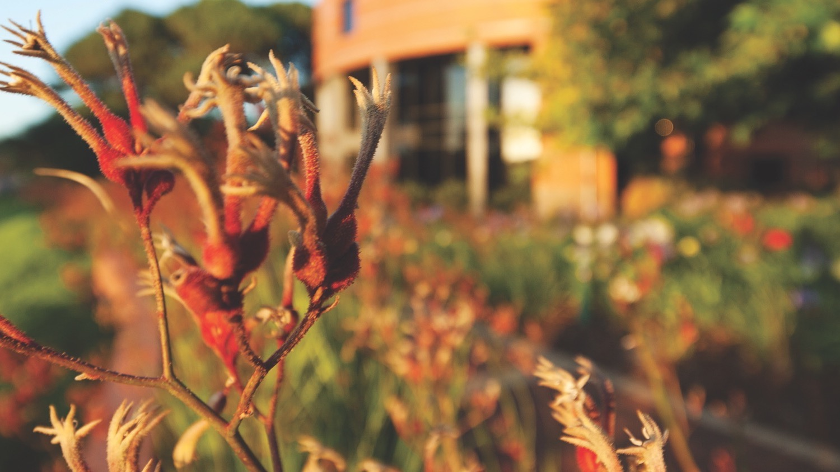
Thank you
Make tomorrow better.

