Slide 1
ROC structure, support & services - general
Graduate Research School:
Higher Degree by Research Students (Doctoral & Masters) Orientation
21 July 2022
RESEARCH INTEGRITY, ETHICS, HAZARDS & SAFETY
Jennifer Hoffman, Manager, Research Integrity

Slide 2
Higher Degree Research: Welcome to the World of Research Integrity

Slide 3
Principles of Responsible Research Conduct
Honesty
in the development, undertaking and reporting of research.
Respect
for research participants, the wider community, animals and the environment.
of the right of Aboriginal and Torres Strait Islander peoples to be engaged in research that affects or is of particular significance to them.
Rigour
in the development, undertaking and reporting of research.
Recognition
Transparency
in declaring interests and reporting research methodology, data and findings.
Accountability
for the development, undertaking and reporting of research.
Fairness
Promotion
in the treatment of others.
of responsible research practices.

Slide 4
Responsibilities as a Curtin HDR student
There are 29 responsibilities of researchers under The Australian Code for the Responsible Conduct of Research
In addition there are a number of other responsibilities under legislation, regulations and Curtin policies and procedures
It is your responsibility to understand all of your obligations and to comply with them
https://www.nhmrc.gov.au/about-us/publications/australian-code-responsible-conduct-research-2018

Slide 5
Which research policy applies?
Curtin University – Responsible Conduct of Research Policy:
3.1. Researchers will comply with the research standards as set out by The Australian Code for the Responsible Conduct of Research.
3.2. The Code sets out research standards through the principles of responsible research conduct and the responsibilities of Curtin University and researchers. Where the researcher is a student at this university Statute No. 10 – Student Discipline and the associated rules also apply.
3.3. If undertaking research at a Curtin global campus, or research in another non-Australian location, researchers will also comply with that country’s research code. Where there is a difference in standards, researchers will comply with the higher standard.

Slide 6
Research Initiation Guide
The Research Initiation Guide (RIG) is a tool to help you understand your responsibilities and legal obligations as a researcher – integrity (in publishing, collaborating etc); ethics; safety – biohazards, radiation; chemical hazards; Defence Trade Controls.
It provides direction on how you can meet these responsibilities and obligations
When starting a new project, you must use the RIG help you understand any permits, licences or approvals you may need before commencing your research
https://rig.curtin.edu.au/home

Slide 7
Research Initiation Guide
What is the purpose of the RIG?
To help you to identify and obtain the permissions you need to get before you can start work.
To train you about how to safely handle any hazardous research materials.
To train you about how to protect yourself, and your research participants, from the impacts of your research.
Who should complete it?
HDR Students.
Research Staff (who control the research methods used).
Supervisors of Honours Students.
Teaching Staff (who control course content).
When should it be completed?
Complete a RIG during the early planning stages of any new work and review it whenever your work changes.
HDR Students - complete a RIG during your Candidacy planning process and annually review it at each milestone.
Research Staff - complete a RIG during the early planning stage of your research before seeking funding and review it whenever you vary your project.
Supervisors of Honours Students - complete a RIG if you are planning for your Honours Student to do a project outside the scope of your normal research.
Teaching Staff – complete a RIG during the early course development and review it whenever you update your course.
Why should you use it?
Many of the materials and techniques used for research and teaching are regulated by the Australian Government and require a permission to be granted before you can use those materials or techniques. If you don’t get the required permissions before you start work then you will have broken the law and may be prosecuted.
https://rig.curtin.edu.au/home

Slide 8
Research Misconduct
Research misconduct occurs when researchers fail to meet their obligations and responsibilities and do not conduct research with integrity
People, animals, environment
Society
Impacts
University
Retraction of papers and research outputs
Return of research funds
Breakdown of research collaborations
Sanctions such as demotion, termination
Reputational damage
Researcher

Slide 9
Research Integrity “hot spots” for HDR Students
First principles: honesty, rigour, fairness
Managing Ethics
Authorship

Slide 10
Managing Ethics
“Ethics mindset” – particularly for non-traditional ethics areas
Approved protocols are strict
Can possibly vary ethics protocols but defects cannot be ‘cured’
Dealing with InfoEd

Slide 11
Authorship
GHOSTING, GIFTING, FAILING TO INCLUDE AUTHORS, ORDER OF AUTHORS...
Section 5 of the Code: Attribution of authorship depends to some extent on the discipline, but in all cases, authorship must be based on substantial contributions in a combination of:
conception and design of the project;
analysis and interpretation of research data; and
drafting significant parts of the work or critically revising it so as to contribute to the interpretation”

Slide 12
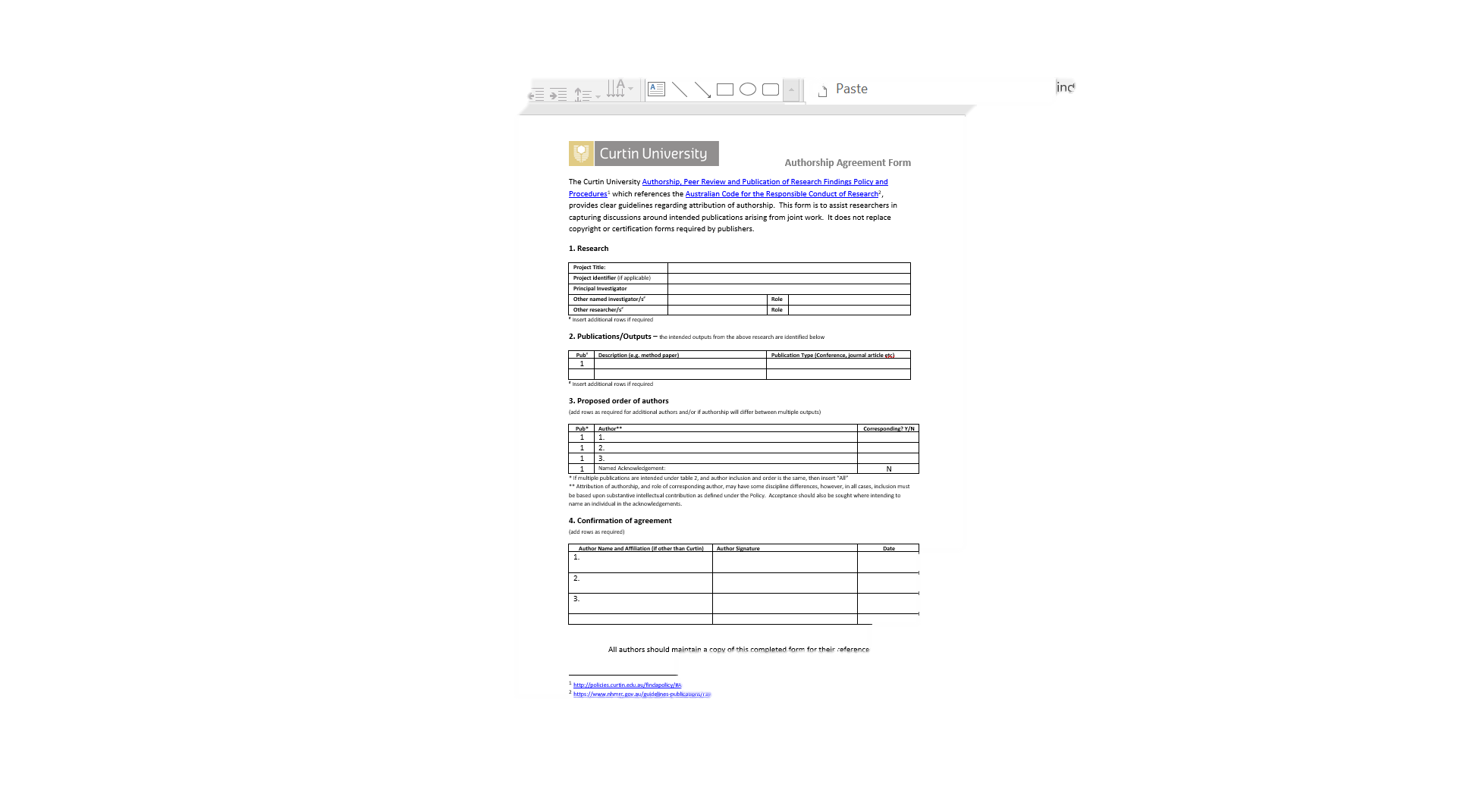
Authorship Agreements are your friend!

Slide 13
Contact us
Research Ethics Team
Animal Facility Team
Team Leader Ethics: Amy Bowater
Senior Research Services Officer: Heather Johnson
Research Services Officer : Diana Dalla Costa
Stephanie Holmquest
Ash Jenkins
Human Ethics Animal Ethics
P: x9223 P: x9223
E: ROC-ethics@curtin.edu.au E: aec@curtin.edu.au
Animal Welfare Officer: Dr Tara Pike
Facility Manager: Carolyn Doyle
Animal Technician: Sam Mansfield
P: x3469
E: L_ResearchFacility@curtin.edu.au
Clinical Trials
Research Integrity
Clinical Research Advisor: Anneli Robbshaw
P: x9292
E: ROC-clinicaltrials@curtin.edu.au
Manager Research Integrity: Jennifer Hoffman
P: x7093
E: research-integrity@curtin.edu.au

